Slide 1
Structural Diagrams

Slide 2
3 basic building blocks of UML - Diagrams
Graphical representation of a set of elements.
Represented by a connected graph: Vertices are things; Arcs are relationships/behaviors.
5 most common views built from
UML 1.x: 9 diagram types.
UML 2.0: 12 diagram types
Structural Diagrams
Represent the static aspects of a system.
  Class;
  Object
  Component
  Deployment
Structural Diagrams
  Class;
  Object
  Component
  Deployment
  Composite Structure
  Package
Behavioral Diagrams
Represent the dynamic aspects.
  Use case
  Sequence;
  Collaboration
  Statechart
  Activity
Behavioral Diagrams
  Use case
  Statechart
  Activity
Interaction Diagrams
  Sequence;
  Communication
  Interaction Overview
  Timing

Slide 3
Component Diagram
UML1.x – implementation view
Shows a set of components and their relationships.
Represents the static implementation view of a system.
Components map to one or more classes, interfaces, or collaborations.
Mapping of Components into Classes
Components and their Relationships
loanOfficer.dll
component
Registrar.exe
LoanOfficer
CreditSearch
Course.dll
LoanPolicy
Student.dll
classes

Slide 4
Component Diagram
UML2.0 – architectural view
Explicit description of interfaces:
provided services to other components
requested services from other components
Component
lollipop
Component
socket
An interface is a collection of 1..* methods, and 0..* attributes
Interfaces can consist of synchronous and / or asynchronous operations
A port (square) is an interaction point between the component and its environment.
Can be named; Can support uni-directional (either provide or require) or bi-directional (both provide and require) communication; Can support multiple interfaces.
possibly concurrent interactions
fully isolate an object’s internals from its environment
caller or callee?
security
AccessControl
StudentAdministration
Student
Encription
Incoming signals/calls
Persistence
Outgoing signals/calls
StudentSchedule
Data[1..*]
DataAccess
Notes:
See UML text pg. 347 (figure 25-3) for an example.

Slide 5
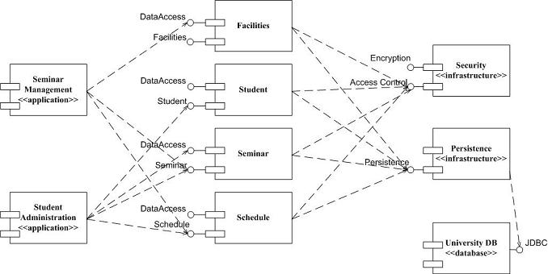
Component Diagram: UML 1.x and UML 2.0
(http://www.agilemodeling.com/artifacts/componentDiagram.htm)

Slide 6
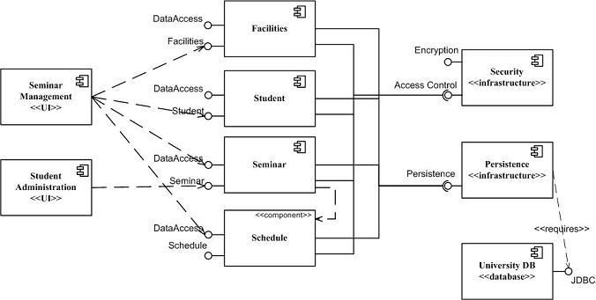
Component Diagram: UML 1.x and UML 2.0
(http://www.agilemodeling.com/artifacts/componentDiagram.htm)
So, how many different conventions for components in UML2.0?

Slide 7
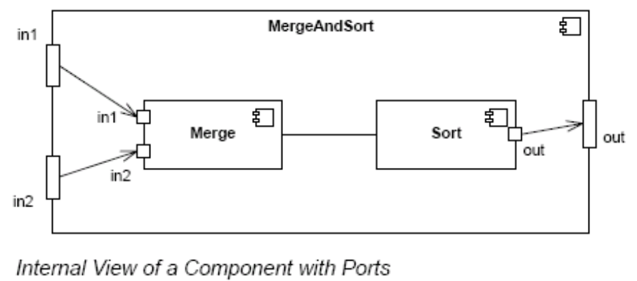
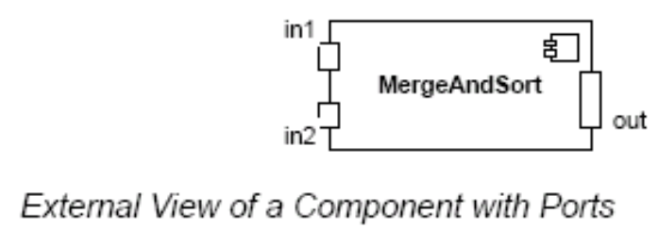
Component Diagram – Connector & Another Example
a connector: just a link between two or more connectable elements (e.g., ports or interfaces)
2 kinds of connectors: assembly and delegation. For “wiring”
  An assembly connector: a binding between a provided interface and a required interface (or ports) that indicates that one component provides the services required by another; simple line/ball-and-socket/lollipop-socket notation
  A delegation connector binds a component’s external behavior (as specified at a port) to an internal realization of that behavior by one of its parts (provide-provide, request-request).
delegation
delegation
assembly
connector
store
Left delegation: direction of arrowhead indicates
“provides”
So, what levels of abstractions for connections?
Right delegation: direction of arrowhead indicates
“requests”
Notes:
See UML text pg. 347 (figure 25-3) for an example.

Slide 8
Deployment Diagram
Shows a set of processing nodes and their relationships.
Represents the static deployment view of an architecture.
Nodes typically enclose one or more components.
TCP/IP
IIS + PhP Server
TCP/IP
J2EE Server
Membership Server
DecNet
Tomcat Server

Slide 9
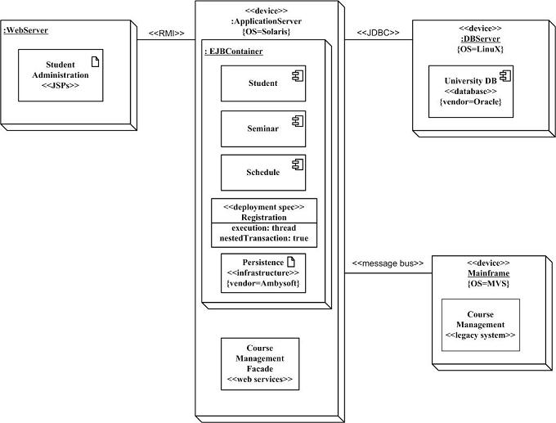
Structural Diagrams - Deployment Diagram
(http://www.agilemodeling.com/artifacts/deploymentDiagram.htm)
Student administration application
Physical nodes - stereotype device
WebServer - physical device or
software artifact
RMI/message bus: connection type
Nodes can contain other nodes
or software artifacts recursively
Deployment specs: configuration files:
name and properties

Slide 10
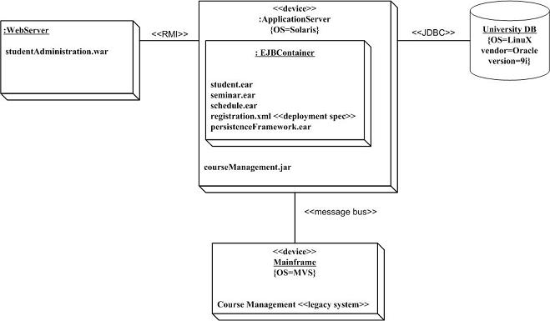
Structural Diagrams - Deployment Diagram
(http://www.agilemodeling.com/artifacts/deploymentDiagram.htm)
Is this better?
More concrete
Implementation-oriented

